Slide 1



Overview of Concurrent & Networked Software Layers: Part 1
Douglas C. Schmidt
d.schmidt@vanderbilt.edu
www.dre.vanderbilt.edu/~schmidt
Professor of Computer Science
Institute for Software Integrated Systems Vanderbilt University Nashville, Tennessee, USA

Slide 2
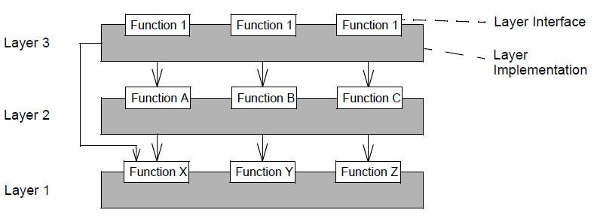
Topics Covered in this Part of the Module
Motivate the need to have a layered architecture for concurrent & networked software
Layer C
Layer B
Layer A
Notes:
http://www.flickr.com/photos/82439748@N00/1155311612/,

Slide 3
Topics Covered in this Part of the Module
Motivate the need for a layered architecture for concurrent & networked software
Describe key concurrent & networked software layers
With an emphasis on middleware
Applications
Domain-Specific
Middleware Services
Common
Middleware Services
Distribution
Middleware
Host Infrastructure
Middleware
Operating Systems
& Protocols
Hardware
Notes:
http://www.flickr.com/photos/82439748@N00/1155311612/,

Slide 4
Separating Concerns in Software Systems
Context | Problems
Concurrent & networked software with many components & developers | Complexity stemming from needed capabilities at many levels of abstraction
Hard to keep track of all the components & all of their dependencies

Slide 5
Separating Concerns in Software Systems
Context | Problems | Solution
Concurrent & networked software with many components & developers | Complexity stemming from needed capabilities at many levels of abstraction | Apply the Layers pattern to create a multi-tier architecture that separates concerns between tasks in different system layers
Layer G
Layer F
Layer E
Layer D
Layer C
Layer B
Layer A
Layers structures software apps & infrastructure by decomposing them into groups of subtasks, with each group residing at a particular level of abstraction

Slide 6
Separating Concerns in Software Systems
Context | Problems | Solution
Concurrent & networked software with many components & developers | Complexity stemming from needed capabilities at many levels of abstraction | Apply the Layers pattern to create a multi-tier architecture that separates concerns between tasks in different system layers
Layer G
Layer F
Layer E
Layer D
Layer C
Layer B
Layer A
posa1.blogspot.com/2008/05/layered-architecture-pattern.html has more info

Slide 7
Layers of Concurrent & Networked Software
Historically, software applications were built directly atop hardware
Applications
Hardware
Notes:
Definitions of the Middleware Layers
Infrastructure middleware. This layer encapsulates core OS communication & concurrency services to eliminate many tedious, error-prone, & non-portable aspects of developing & maintaining distributed applications using low-level network programming mechanisms, such as sockets. Widely-used examples of infrastructure middleware include the Java Virtual Machine (JVM) & the ADAPTIVE Communication Environment (ACE).
Distribution middleware. This layer builds upon the lower-level infrastructure middleware to automate common network programming tasks, such as parameter marshaling/demarshaling, socket & request demultiplexing, & fault detection/recovery. Common examples of distribution middleware include the Object Management Group's (OMG's) Common Object Request Broker Architecture (CORBA), Microsoft's Distributed COM (DCOM), & JavaSoft's Remote Method Invocation (RMI).
Common middleware services. This layer augments the distribution middleware by defining domain-independent services, such as event notifications, logging, multimedia streaming, persistence, security, transactions, fault tolerance, & distributed concurrency control. Applications can reuse these services to perform common distribution tasks that would otherwise be implemented manually.
Domain-specific Services. This layer is tailored to the requirements of particular domains, such as telecommunications, e-commerce, health-care, or process automation. Unlike the other three OO middleware layers, domain-specific services are not as generally reusable, & thus are the least mature of the middleware layers today. Since they embody domain-specific knowledge, however, they have the most potential to increase system quality & decrease the cycle-time & effort required to develop particular types of networked applications.

Slide 8
Layers of Concurrent & Networked Software
Historically, software applications were built directly atop hardware
& OS
& OS
Applications
Operating Systems
& Protocols
Hardware
Notes:
Definitions of the Middleware Layers
Infrastructure middleware. This layer encapsulates core OS communication & concurrency services to eliminate many tedious, error-prone, & non-portable aspects of developing & maintaining distributed applications using low-level network programming mechanisms, such as sockets. Widely-used examples of infrastructure middleware include the Java Virtual Machine (JVM) & the ADAPTIVE Communication Environment (ACE).
Distribution middleware. This layer builds upon the lower-level infrastructure middleware to automate common network programming tasks, such as parameter marshaling/demarshaling, socket & request demultiplexing, & fault detection/recovery. Common examples of distribution middleware include the Object Management Group's (OMG's) Common Object Request Broker Architecture (CORBA), Microsoft's Distributed COM (DCOM), & JavaSoft's Remote Method Invocation (RMI).
Common middleware services. This layer augments the distribution middleware by defining domain-independent services, such as event notifications, logging, multimedia streaming, persistence, security, transactions, fault tolerance, & distributed concurrency control. Applications can reuse these services to perform common distribution tasks that would otherwise be implemented manually.
Domain-specific Services. This layer is tailored to the requirements of particular domains, such as telecommunications, e-commerce, health-care, or process automation. Unlike the other three OO middleware layers, domain-specific services are not as generally reusable, & thus are the least mature of the middleware layers today. Since they embody domain-specific knowledge, however, they have the most potential to increase system quality & decrease the cycle-time & effort required to develop particular types of networked applications.

Slide 9
Layers of Concurrent & Networked Software
Historically, software applications were built directly atop hardware
& OS
& OS
Applications
Tedious, error-prone, & costly over lifecycles
Operating Systems
& Protocols
Hardware
Notes:
Definitions of the Middleware Layers
Infrastructure middleware. This layer encapsulates core OS communication & concurrency services to eliminate many tedious, error-prone, & non-portable aspects of developing & maintaining distributed applications using low-level network programming mechanisms, such as sockets. Widely-used examples of infrastructure middleware include the Java Virtual Machine (JVM) & the ADAPTIVE Communication Environment (ACE).
Distribution middleware. This layer builds upon the lower-level infrastructure middleware to automate common network programming tasks, such as parameter marshaling/demarshaling, socket & request demultiplexing, & fault detection/recovery. Common examples of distribution middleware include the Object Management Group's (OMG's) Common Object Request Broker Architecture (CORBA), Microsoft's Distributed COM (DCOM), & JavaSoft's Remote Method Invocation (RMI).
Common middleware services. This layer augments the distribution middleware by defining domain-independent services, such as event notifications, logging, multimedia streaming, persistence, security, transactions, fault tolerance, & distributed concurrency control. Applications can reuse these services to perform common distribution tasks that would otherwise be implemented manually.
Domain-specific Services. This layer is tailored to the requirements of particular domains, such as telecommunications, e-commerce, health-care, or process automation. Unlike the other three OO middleware layers, domain-specific services are not as generally reusable, & thus are the least mature of the middleware layers today. Since they embody domain-specific knowledge, however, they have the most potential to increase system quality & decrease the cycle-time & effort required to develop particular types of networked applications.

Slide 10
Layers of Concurrent & Networked Software
Historically, software applications were built directly atop hardware
& OS
& OS
Applications
Tedious, error-prone, & costly over lifecycles
Domain-Specific
Middleware Services
Middleware is reusable infrastructure software residing between applications & the underlying operating systems, networks, & hardware
There are layers of middleware, just like there are layers of networking protocols
Common
Middleware Services
Distribution
Middleware
Host Infrastructure
Middleware
Operating Systems
& Protocols
Hardware
Notes:
Definitions of the Middleware Layers
Infrastructure middleware. This layer encapsulates core OS communication & concurrency services to eliminate many tedious, error-prone, & non-portable aspects of developing & maintaining distributed applications using low-level network programming mechanisms, such as sockets. Widely-used examples of infrastructure middleware include the Java Virtual Machine (JVM) & the ADAPTIVE Communication Environment (ACE).
Distribution middleware. This layer builds upon the lower-level infrastructure middleware to automate common network programming tasks, such as parameter marshaling/demarshaling, socket & request demultiplexing, & fault detection/recovery. Common examples of distribution middleware include the Object Management Group's (OMG's) Common Object Request Broker Architecture (CORBA), Microsoft's Distributed COM (DCOM), & JavaSoft's Remote Method Invocation (RMI).
Common middleware services. This layer augments the distribution middleware by defining domain-independent services, such as event notifications, logging, multimedia streaming, persistence, security, transactions, fault tolerance, & distributed concurrency control. Applications can reuse these services to perform common distribution tasks that would otherwise be implemented manually.
Domain-specific Services. This layer is tailored to the requirements of particular domains, such as telecommunications, e-commerce, health-care, or process automation. Unlike the other three OO middleware layers, domain-specific services are not as generally reusable, & thus are the least mature of the middleware layers today. Since they embody domain-specific knowledge, however, they have the most potential to increase system quality & decrease the cycle-time & effort required to develop particular types of networked applications.

Slide 11
Layers of Concurrent & Networked Software
Historically, software applications were built directly atop hardware
& OS
& OS
Applications
Tedious, error-prone, & costly over lifecycles
Domain-Specific
Middleware Services
Middleware is reusable infrastructure software residing between applications & the underlying operating systems, networks, & hardware
There are layers of middleware, just like there are layers of networking protocols
Common
Middleware Services
Distribution
Middleware
Host Infrastructure
Middleware
Operating Systems
& Protocols
Hardware
www.dre.vanderbilt.edu/~schmidt/PDF/middleware-encyclopedia.pdf has more
Notes:
Definitions of the Middleware Layers
Infrastructure middleware. This layer encapsulates core OS communication & concurrency services to eliminate many tedious, error-prone, & non-portable aspects of developing & maintaining distributed applications using low-level network programming mechanisms, such as sockets. Widely-used examples of infrastructure middleware include the Java Virtual Machine (JVM) & the ADAPTIVE Communication Environment (ACE).
Distribution middleware. This layer builds upon the lower-level infrastructure middleware to automate common network programming tasks, such as parameter marshaling/demarshaling, socket & request demultiplexing, & fault detection/recovery. Common examples of distribution middleware include the Object Management Group's (OMG's) Common Object Request Broker Architecture (CORBA), Microsoft's Distributed COM (DCOM), & JavaSoft's Remote Method Invocation (RMI).
Common middleware services. This layer augments the distribution middleware by defining domain-independent services, such as event notifications, logging, multimedia streaming, persistence, security, transactions, fault tolerance, & distributed concurrency control. Applications can reuse these services to perform common distribution tasks that would otherwise be implemented manually.
Domain-specific Services. This layer is tailored to the requirements of particular domains, such as telecommunications, e-commerce, health-care, or process automation. Unlike the other three OO middleware layers, domain-specific services are not as generally reusable, & thus are the least mature of the middleware layers today. Since they embody domain-specific knowledge, however, they have the most potential to increase system quality & decrease the cycle-time & effort required to develop particular types of networked applications.

Slide 12
Layers of Concurrent & Networked Software
Historically, software applications were built directly atop hardware
& OS
& OS
Applications
Tedious, error-prone, & costly over lifecycles
Domain-Specific
Middleware Services
Middleware is reusable infrastructure software residing between applications & the underlying operating systems, networks, & hardware
There are layers of middleware, just like there are layers of networking protocols
Common
Middleware Services
Distribution
Middleware
Host Infrastructure
Middleware
Standards-based off-the-shelf middleware helps:
Leverage hardware & software technology advances
Operating Systems
& Protocols
Hardware
Notes:
Definitions of the Middleware Layers
Infrastructure middleware. This layer encapsulates core OS communication & concurrency services to eliminate many tedious, error-prone, & non-portable aspects of developing & maintaining distributed applications using low-level network programming mechanisms, such as sockets. Widely-used examples of infrastructure middleware include the Java Virtual Machine (JVM) & the ADAPTIVE Communication Environment (ACE).
Distribution middleware. This layer builds upon the lower-level infrastructure middleware to automate common network programming tasks, such as parameter marshaling/demarshaling, socket & request demultiplexing, & fault detection/recovery. Common examples of distribution middleware include the Object Management Group's (OMG's) Common Object Request Broker Architecture (CORBA), Microsoft's Distributed COM (DCOM), & JavaSoft's Remote Method Invocation (RMI).
Common middleware services. This layer augments the distribution middleware by defining domain-independent services, such as event notifications, logging, multimedia streaming, persistence, security, transactions, fault tolerance, & distributed concurrency control. Applications can reuse these services to perform common distribution tasks that would otherwise be implemented manually.
Domain-specific Services. This layer is tailored to the requirements of particular domains, such as telecommunications, e-commerce, health-care, or process automation. Unlike the other three OO middleware layers, domain-specific services are not as generally reusable, & thus are the least mature of the middleware layers today. Since they embody domain-specific knowledge, however, they have the most potential to increase system quality & decrease the cycle-time & effort required to develop particular types of networked applications.

Slide 13
Layers of Concurrent & Networked Software
Historically, software applications were built directly atop hardware
& OS
& OS
Applications
Tedious, error-prone, & costly over lifecycles
Domain-Specific
Middleware Services
Middleware is reusable infrastructure software residing between applications & the underlying operating systems, networks, & hardware
There are layers of middleware, just like there are layers of networking protocols
Common
Middleware Services
Distribution
Middleware
Host Infrastructure
Middleware
Standards-based off-the-shelf middleware helps:
Leverage hardware & software technology advances
Evolve to new requirements & environments
Operating Systems
& Protocols
Hardware
Notes:
Definitions of the Middleware Layers
Infrastructure middleware. This layer encapsulates core OS communication & concurrency services to eliminate many tedious, error-prone, & non-portable aspects of developing & maintaining distributed applications using low-level network programming mechanisms, such as sockets. Widely-used examples of infrastructure middleware include the Java Virtual Machine (JVM) & the ADAPTIVE Communication Environment (ACE).
Distribution middleware. This layer builds upon the lower-level infrastructure middleware to automate common network programming tasks, such as parameter marshaling/demarshaling, socket & request demultiplexing, & fault detection/recovery. Common examples of distribution middleware include the Object Management Group's (OMG's) Common Object Request Broker Architecture (CORBA), Microsoft's Distributed COM (DCOM), & JavaSoft's Remote Method Invocation (RMI).
Common middleware services. This layer augments the distribution middleware by defining domain-independent services, such as event notifications, logging, multimedia streaming, persistence, security, transactions, fault tolerance, & distributed concurrency control. Applications can reuse these services to perform common distribution tasks that would otherwise be implemented manually.
Domain-specific Services. This layer is tailored to the requirements of particular domains, such as telecommunications, e-commerce, health-care, or process automation. Unlike the other three OO middleware layers, domain-specific services are not as generally reusable, & thus are the least mature of the middleware layers today. Since they embody domain-specific knowledge, however, they have the most potential to increase system quality & decrease the cycle-time & effort required to develop particular types of networked applications.

Slide 14
Layers of Concurrent & Networked Software
Historically, software applications were built directly atop hardware
& OS
& OS
Applications
Tedious, error-prone, & costly over lifecycles
Domain-Specific
Middleware Services
Middleware is reusable infrastructure software residing between applications & the underlying operating systems, networks, & hardware
There are layers of middleware, just like there are layers of networking protocols
Common
Middleware Services
Distribution
Middleware
Host Infrastructure
Middleware
Standards-based off-the-shelf middleware helps:
Leverage hardware & software technology advances
Evolve to new requirements & environments
Provide an array of reusable, off-the-shelf developer-oriented services
Operating Systems
& Protocols
Hardware
Notes:
Definitions of the Middleware Layers
Infrastructure middleware. This layer encapsulates core OS communication & concurrency services to eliminate many tedious, error-prone, & non-portable aspects of developing & maintaining distributed applications using low-level network programming mechanisms, such as sockets. Widely-used examples of infrastructure middleware include the Java Virtual Machine (JVM) & the ADAPTIVE Communication Environment (ACE).
Distribution middleware. This layer builds upon the lower-level infrastructure middleware to automate common network programming tasks, such as parameter marshaling/demarshaling, socket & request demultiplexing, & fault detection/recovery. Common examples of distribution middleware include the Object Management Group's (OMG's) Common Object Request Broker Architecture (CORBA), Microsoft's Distributed COM (DCOM), & JavaSoft's Remote Method Invocation (RMI).
Common middleware services. This layer augments the distribution middleware by defining domain-independent services, such as event notifications, logging, multimedia streaming, persistence, security, transactions, fault tolerance, & distributed concurrency control. Applications can reuse these services to perform common distribution tasks that would otherwise be implemented manually.
Domain-specific Services. This layer is tailored to the requirements of particular domains, such as telecommunications, e-commerce, health-care, or process automation. Unlike the other three OO middleware layers, domain-specific services are not as generally reusable, & thus are the least mature of the middleware layers today. Since they embody domain-specific knowledge, however, they have the most potential to increase system quality & decrease the cycle-time & effort required to develop particular types of networked applications.

Slide 15
Layers of Concurrent & Networked Software
Historically, software applications were built directly atop hardware
& OS
& OS
Applications
Tedious, error-prone, & costly over lifecycles
Domain-Specific
Middleware Services
Middleware is reusable infrastructure software residing between applications & the underlying operating systems, networks, & hardware
There are layers of middleware, just like there are layers of networking protocols
Common
Middleware Services
Distribution
Middleware
Host Infrastructure
Middleware
Standards-based off-the-shelf middleware helps:
Leverage hardware & software technology advances
Evolve to new requirements & environments
Provide an array of reusable, off-the-shelf developer-oriented services
Control end-to-end resources & quality-of-service (QoS)
Operating Systems
& Protocols
Hardware
Notes:
Definitions of the Middleware Layers
Infrastructure middleware. This layer encapsulates core OS communication & concurrency services to eliminate many tedious, error-prone, & non-portable aspects of developing & maintaining distributed applications using low-level network programming mechanisms, such as sockets. Widely-used examples of infrastructure middleware include the Java Virtual Machine (JVM) & the ADAPTIVE Communication Environment (ACE).
Distribution middleware. This layer builds upon the lower-level infrastructure middleware to automate common network programming tasks, such as parameter marshaling/demarshaling, socket & request demultiplexing, & fault detection/recovery. Common examples of distribution middleware include the Object Management Group's (OMG's) Common Object Request Broker Architecture (CORBA), Microsoft's Distributed COM (DCOM), & JavaSoft's Remote Method Invocation (RMI).
Common middleware services. This layer augments the distribution middleware by defining domain-independent services, such as event notifications, logging, multimedia streaming, persistence, security, transactions, fault tolerance, & distributed concurrency control. Applications can reuse these services to perform common distribution tasks that would otherwise be implemented manually.
Domain-specific Services. This layer is tailored to the requirements of particular domains, such as telecommunications, e-commerce, health-care, or process automation. Unlike the other three OO middleware layers, domain-specific services are not as generally reusable, & thus are the least mature of the middleware layers today. Since they embody domain-specific knowledge, however, they have the most potential to increase system quality & decrease the cycle-time & effort required to develop particular types of networked applications.

Slide 16
Operating System & Protocols
Operating systems & protocols provide infrastructure mechanisms to manage end system resources, e.g.,
CPU scheduling & process/thread dispatching
Virtual memory management
Secondary storage, persistence, & file systems
Local & remote inter-process communication (IPC)
Domain-Specific
Middleware Services
Common
Middleware Services
Distribution
Middleware
Host Infrastructure
Middleware
Operating Systems & Protocols

Slide 17

Operating System & Protocols
Operating systems & protocols provide infrastructure mechanisms to manage end system resources, e.g.,
CPU scheduling & process/thread dispatching
Virtual memory management
Secondary storage, persistence, & file systems
Local & remote inter-process communication (IPC)
Examples
Operating systems: UNIX/Linux, Windows, VxWorks, LynxOS, etc.
Protocols: TCP, UDP, IP, SCTP, SIP, RTP, HTTP, etc.
Domain-Specific
Middleware Services
Common
Middleware Services
Distribution
Middleware
Host Infrastructure
Middleware
Operating Systems & Protocols
Notes:
http://www.flickr.com/photos/97058136@N00/4545569408/

Slide 18
Host Infrastructure Middleware
Host infrastructure middleware encapsulates/enhances native OS mechanisms to create reusable OO components
These components abstract away many tedious & error-prone aspects of low-level OS APIs
Domain-Specific
Middleware Services
Common
Middleware Services
Distribution
Middleware
Host Infrastructure
Middleware
Operating Systems & Protocols

Slide 19
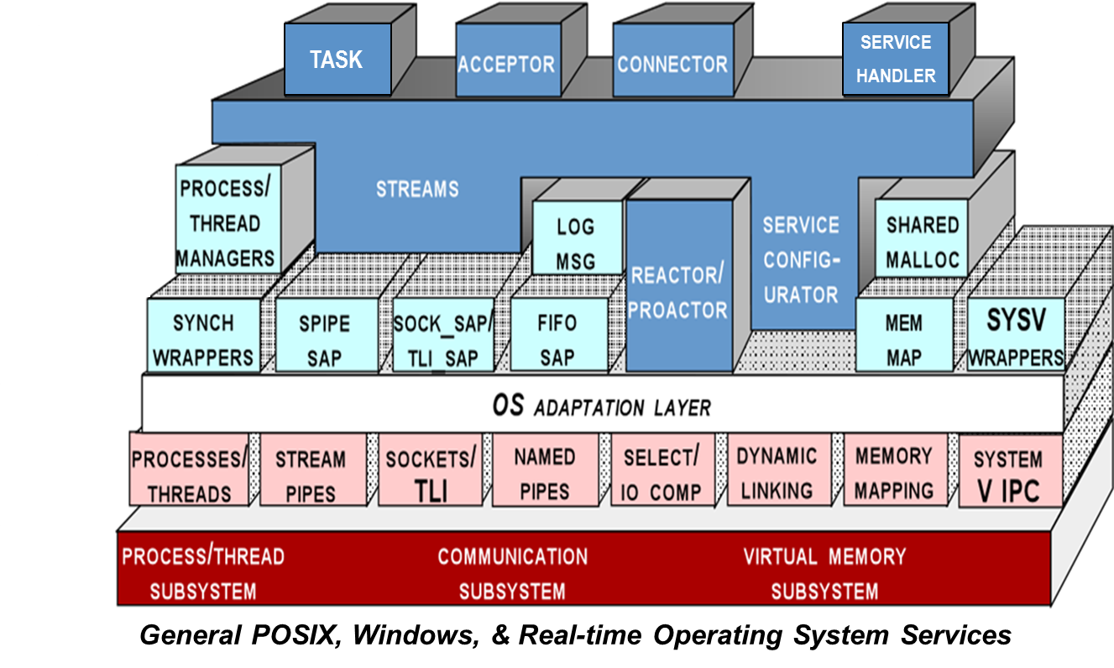
Host Infrastructure Middleware
Host infrastructure middleware encapsulates/enhances native OS mechanisms to create reusable OO components
These components abstract away many tedious & error-prone aspects of low-level OS APIs
Domain-Specific
Middleware Services
Common
Middleware Services
Distribution
Middleware
Examples
Java Virtual Machine (JVM), Common Language Runtime (CLR), ADAPTIVE Communication Environment (ACE), etc.
Host Infrastructure
Middleware
Operating Systems & Protocols
Asynchronous
Event Handling
Asynchronous
Transfer of
Control
Physical
Memory
Access
Synchronization
Memory
Management
Scheduling
www.rtsj.org
www.dre.vanderbilt.edu/ACE

Slide 20
Distribution Middleware
Distribution middleware simplifies networked component programming & extends OS mechanisms end-to-end
Domain-Specific
Middleware Services
Common
Middleware Services
Distribution
Middleware
Host Infrastructure
Middleware
Operating Systems & Protocols

Slide 21
Distribution Middleware
Distribution middleware simplifies networked component programming & extends OS mechanisms end-to-end
Domain-Specific
Middleware Services
Common
Middleware Services
Examples
OMG (Real-time) CORBA & DDS, W3C SOAP & Web Services, Sun RMI, Microsoft DCOM, etc.
Distribution
Middleware
Host Infrastructure
Middleware
Operating Systems & Protocols
write
read
App
App
Global Data Store
write
App
write
write
App
read
read
App
www.omg.org/corba
www.omg.org/dds
Distribution middleware avoids hard-coding client & server app dependencies on object location, language, OS, protocols, & hardware

Slide 22
Common Middleware Services
Common middleware services define higher-level domain-independent services
Domain-Specific
Middleware Services
Common
Middleware Services
Distribution
Middleware
Host Infrastructure
Middleware
Operating Systems & Protocols

Slide 23
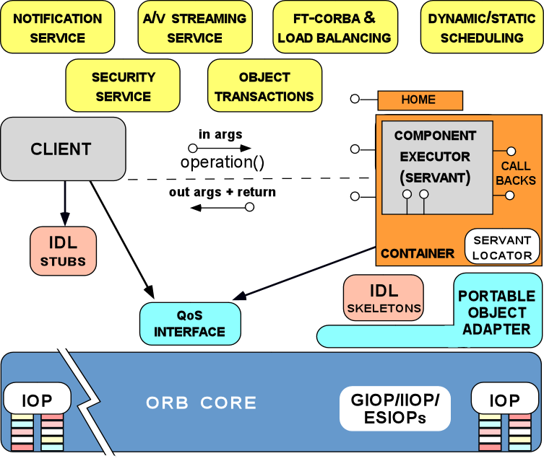
Common Middleware Services
Common middleware services define higher-level domain-independent services
Domain-Specific
Middleware Services
Common
Middleware Services
Examples
CORBA Component Model & Object Services, Sun’s J2EE, Microsoft’s .NET, W3C Web Services, etc.
Distribution
Middleware
Host Infrastructure
Middleware
Operating Systems & Protocols
Common middleware services support many reusable distributed computing capabilities, e.g.,
Transactional behavior
Authentication & authorization,
Database connection pooling & concurrency control
Active/passive replication
Dynamic resource management

Slide 24
Domain-Specific Middleware Services
Domain-specific middleware services are tailored to the requirements of particular domains, such as telecom, e-commerce, health care, process automation, or aerospace
Domain-Specific
Middleware Services
Common
Middleware Services
Distribution
Middleware
Host Infrastructure
Middleware
Operating Systems & Protocols

Slide 25
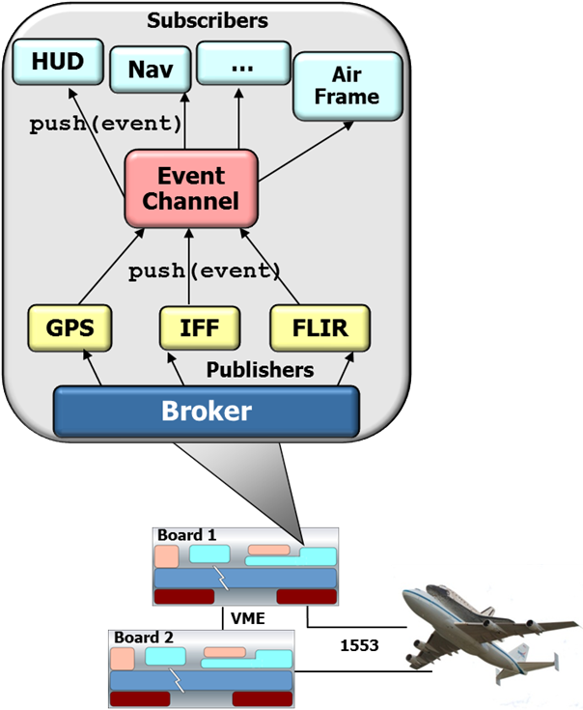
Domain-Specific Middleware Services
Domain-specific middleware services are tailored to the requirements of particular domains, such as telecom, e-commerce, health care, process automation, or aerospace
Domain-Specific
Middleware Services
Common
Middleware Services
Examples
Distribution
Middleware
Host Infrastructure
Middleware
Operating Systems & Protocols
Avionics Control Systems
Common software platform for avionics control systems

Slide 26
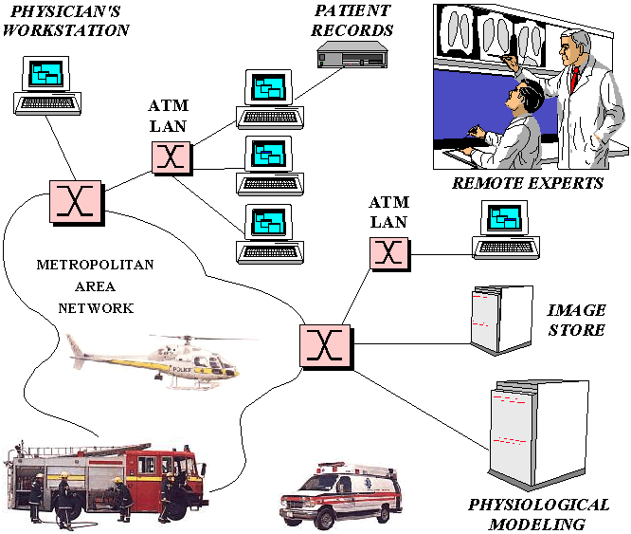
Domain-Specific Middleware Services
Domain-specific middleware services are tailored to the requirements of particular domains, such as telecom, e-commerce, health care, process automation, or aerospace
Domain-Specific
Middleware Services
Common
Middleware Services
Examples
Distribution
Middleware
Electronic Medical Information Systems
Common software platform for distributed electronic medical systems
Host Infrastructure
Middleware
Operating Systems & Protocols
Avionics Control Systems
Common software platform for avionics control systems
Modalities
e.g., MRI, CT, CR, Ultrasound, etc.

Slide 27

Pros & Cons of the Layers Pattern
This pattern has several benefits:
Reuse of layers
If an individual layer embodies a well-defined & documented interface it can be reused in multiple contexts
Notes:
http://en.wikipedia.org/wiki/File:Recycle001.svg

Slide 28









Pros & Cons of the Layers Pattern
This pattern has several benefits:
Reuse of layers
If an individual layer embodies a well-defined & documented interface it can be reused in multiple contexts
Support for standardization
Clearly-defined levels of abstraction enable standardized tasks & interfaces
Domain-Specific
Middleware Services
Common
Middleware Services
Distribution
Middleware
Host Infrastructure
Middleware
Operating Systems
& Protocols
Hardware

Slide 29

Pros & Cons of the Layers Pattern
This pattern has several benefits:
Reuse of layers
If an individual layer embodies a well-defined & documented interface it can be reused in multiple contexts
Support for standardization
Clearly-defined levels of abstraction enable standardized tasks & interfaces
Dependencies are localized
Standardized layer interfaces usually confine the effect of code changes to the layer that changes
Notes:
http://www.flickr.com/photos/63442123@N00/3794759550/

Slide 30

Pros & Cons of the Layers Pattern
This pattern has several benefits:
Reuse of layers
If an individual layer embodies a well-defined & documented interface it can be reused in multiple contexts
Support for standardization
Clearly-defined levels of abstraction enable standardized tasks & interfaces
Dependencies are localized
Standardized layer interfaces usually confine the effect of code changes to the layer that changes
Exchangeability
Individual layer implementations can be replaced seamlessly to enable “plug & play” semantics
Notes:
http://www.flickr.com/photos/24420613@N08/3180236074/

Slide 31

Pros & Cons of the Layers Pattern
This pattern also has liabilities:
Cascades of changing behavior
If layer interfaces aren’t abstracted properly then changes can ripple
Notes:
http://www.flickr.com/photos/91237943@N00/208714007/

Slide 32

Pros & Cons of the Layers Pattern
This pattern also has liabilities:
Cascades of changing behavior
If layer interfaces aren’t abstracted properly then changes can ripple
Higher overhead
A layered solution may be less efficient than a monolithic one
Notes:
http://en.wikipedia.org/wiki/File:MAN_Atlante_fronte_1040572.JPG

Slide 33

Pros & Cons of the Layers Pattern
This pattern also has liabilities:
Cascades of changing behavior
If layer interfaces aren’t abstracted properly then changes can ripple
Higher overhead
A layered solution may be less efficient than a monolithic one
Unnecessary work
Performance can suffer if services performed by lower layers perform excessive or duplicate work not actually required by the higher layer
Notes:
http://www.flickr.com/photos/13672753@N00/1975003929/

Slide 34

Pros & Cons of the Layers Pattern
This pattern also has liabilities:
Cascades of changing behavior
If layer interfaces aren’t abstracted properly then changes can ripple
Higher overhead
A layered solution may be less efficient than a monolithic one
Unnecessary work
Performance can suffer if services performed by lower layers perform excessive or duplicate work not actually required by the higher layer
Difficulty of establishing the correct granularity of layers
It’s important to avoid too many & too few layers
Notes:
http://www.flickr.com/photos/9319517@N06/5926405576/

Slide 35
Summary
Today’s concurrent & networked software systems consist of capabilities provided by multiple layers of middleware, operating system, protocols, & hardware
Applications
Domain-Specific
Middleware Services
Common
Middleware Services
Distribution
Middleware
Host Infrastructure
Middleware
Operating Systems
& Protocols
Hardware
Notes:
Key Themes of This Slide
Information technology (IT) is rapidly becoming a commodity. For the past decade we've benefited from the commoditization of hardware, such as CPUs & storage devices, & networking elements, such as IP routers, which get faster, cheaper, & better at a predictable pace. More recently, advances in programming languages, such as Java & C++, operating environments, such as POSIX & Java Virtual Machines, & middleware, such as CORBA & Enterprise Java Beans, are helping to commoditize many software layers & components, as well. Although the quality of commodity software--particularly communication software--has lagged behind hardware, recent improvements have enabled common off-the-shelf (COTS) software components to be used in an increasing number of mission-critical applications, ranging from avionics mission computing to hot rolling mills & backbone routers & switches.
The commoditization of IT has a number of consequences:
Focus on integration rather than programming -- There is an ongoing trend away from programming systems from scratch to integrating them by configuring & customizing reusable components. While it is possible in theory to program systems from scratch, economic & organizational constraints--as well as increasingly complex requirements & competitive pressures--often makes it economically infeasible to do so in practice. Thus, most systems in the future will be configured by integrating commodity reusable components implemented by different suppliers.
Technology convergence & standardization -- To leverage inexpensive commodity hardware & software effectively, application developers are converging towards fewer general-purpose tools, platforms, & methods than they've used in the past. For example, rather than choosing from dozens of programming languages, operating systems, network protocols, & middleware, newer systems are being developed with a relatively small number of common tools & platforms, such as C++, Java, UNIX, Windows NT, TCP/IP, & CORBA, most of which are industry standards. Likewise, there's a general consolidation of development methods & modeling notations away from ad hoc techniques towards industry standards, such as UML.
Mass market technology & personnel economies of scale -- Due to technology convergence, there is an increasing abundance of good technology & personnel at competitive prices for mainstream mass markets, such as e-commerce or consumer electronics built using general-purpose operating systems, languages, networks, & middleware. However, for niche markets, such as real-time embedded systems written using proprietary platforms, languages, & tools, commodity hardware & software artifacts & personnel are much more expensive--if they can be found at all. Thus, the further an industry diverges from the mainstream mass market, the greater the costs it incurs to develop, deploy, & maintain systems; likewise, the more its customers must pay for the niche technology.
Disruptive technologies & global competition -- Another consequence of IT commoditization is that industries, such as telecommunications & aerospace, that have long been protected by high barriers to entry will be much more vulnerable to disruptive technologies & global competition. For example, advances in high-performance COTS hardware & fault tolerant middleware are making it possible to build dependable network elements ranging from PBXs to high-speed backbone routers--and ultimately carrier class switches--using standard components that cost much less than today's highly proprietary systems. In turn, the commoditization of network elements will continue to erode the profit margins that communication equipment market leaders have enjoyed historically.
The decline of internally funded R&D -- Shrinking profit margins make it increasingly hard for companies to invest heavily in long-term research that doesn't yield short-term pay offs. As a result, many companies can no longer afford the luxury of internal R&D organizations that produce proprietary hardware & software components with customized quality-of-service support. To fill this void, therefore, commodity hardware & software researched & developed by third-parties is becoming increasingly strategic to many industries. However, this trend often requires companies to transition away from proprietary architectures to more open systems in order reap the benefits of externally funded R&D.
Potential complexity cap for next-generation complex systems -- As the current generation of technology transitions run their course, the systemic reduction in long-term research funding may limit the level of complexity of next-generation systems that can be developed & integrated using commoditized hardware & software components. In particular, over the past five years there has been a steady flow of faculty, staff, & grad students out of the traditional research centers, such as universities & research labs, & into startup companies & other industrial positions. While this transition has helped to fuel the current global economic boom, it's unclear whether this trend bodes well for long-term technology innovation. In particular, without an investment in fundamental R&D it may be hard for developers of next-generation systems to address the complexities associated with the move towards large-scale distributed ``systems of systems'' in many domains.
In the face of the relentless drive towards IT commoditization, it's become essential for developers, companies, & even entire countries to consider how they can maintain their competitive edge. As hardware & software components are increasingly being written, fabricated, & deployed as inexpensive commodities via low-cost distribution channels, such as the Internet, traditional market leaders & supply chains are being altered substantially. For example, the meteoric growth of the open-source Linux operating system (OS) has significantly altered the pricing levels, business strategies, and
licensing models of proprietary OS vendors. Thus, in a highly commoditized IT economy, premium value & strategic advantage will accrue to individuals, organizations, & nations that master the patterns, pattern languages, frameworks, components, & middleware tools necessary to develop & integrate complex communication systems.

Slide 36
Summary
Today’s concurrent & networked software systems consist of capabilities provided by multiple layers of middleware, operating system, protocols, & hardware
This course focuses primarily on patterns & frameworks associated with host infrastructure & distribution middleware in support of concurrent & networked apps
Applications
Domain-Specific
Middleware Services
Common
Middleware Services
Distribution
Middleware
Host Infrastructure
Middleware
Operating Systems
& Protocols
Hardware
Notes:
Key Themes of This Slide
Information technology (IT) is rapidly becoming a commodity. For the past decade we've benefited from the commoditization of hardware, such as CPUs & storage devices, & networking elements, such as IP routers, which get faster, cheaper, & better at a predictable pace. More recently, advances in programming languages, such as Java & C++, operating environments, such as POSIX & Java Virtual Machines, & middleware, such as CORBA & Enterprise Java Beans, are helping to commoditize many software layers & components, as well. Although the quality of commodity software--particularly communication software--has lagged behind hardware, recent improvements have enabled common off-the-shelf (COTS) software components to be used in an increasing number of mission-critical applications, ranging from avionics mission computing to hot rolling mills & backbone routers & switches.
The commoditization of IT has a number of consequences:
Focus on integration rather than programming -- There is an ongoing trend away from programming systems from scratch to integrating them by configuring & customizing reusable components. While it is possible in theory to program systems from scratch, economic & organizational constraints--as well as increasingly complex requirements & competitive pressures--often makes it economically infeasible to do so in practice. Thus, most systems in the future will be configured by integrating commodity reusable components implemented by different suppliers.
Technology convergence & standardization -- To leverage inexpensive commodity hardware & software effectively, application developers are converging towards fewer general-purpose tools, platforms, & methods than they've used in the past. For example, rather than choosing from dozens of programming languages, operating systems, network protocols, & middleware, newer systems are being developed with a relatively small number of common tools & platforms, such as C++, Java, UNIX, Windows NT, TCP/IP, & CORBA, most of which are industry standards. Likewise, there's a general consolidation of development methods & modeling notations away from ad hoc techniques towards industry standards, such as UML.
Mass market technology & personnel economies of scale -- Due to technology convergence, there is an increasing abundance of good technology & personnel at competitive prices for mainstream mass markets, such as e-commerce or consumer electronics built using general-purpose operating systems, languages, networks, & middleware. However, for niche markets, such as real-time embedded systems written using proprietary platforms, languages, & tools, commodity hardware & software artifacts & personnel are much more expensive--if they can be found at all. Thus, the further an industry diverges from the mainstream mass market, the greater the costs it incurs to develop, deploy, & maintain systems; likewise, the more its customers must pay for the niche technology.
Disruptive technologies & global competition -- Another consequence of IT commoditization is that industries, such as telecommunications & aerospace, that have long been protected by high barriers to entry will be much more vulnerable to disruptive technologies & global competition. For example, advances in high-performance COTS hardware & fault tolerant middleware are making it possible to build dependable network elements ranging from PBXs to high-speed backbone routers--and ultimately carrier class switches--using standard components that cost much less than today's highly proprietary systems. In turn, the commoditization of network elements will continue to erode the profit margins that communication equipment market leaders have enjoyed historically.
The decline of internally funded R&D -- Shrinking profit margins make it increasingly hard for companies to invest heavily in long-term research that doesn't yield short-term pay offs. As a result, many companies can no longer afford the luxury of internal R&D organizations that produce proprietary hardware & software components with customized quality-of-service support. To fill this void, therefore, commodity hardware & software researched & developed by third-parties is becoming increasingly strategic to many industries. However, this trend often requires companies to transition away from proprietary architectures to more open systems in order reap the benefits of externally funded R&D.
Potential complexity cap for next-generation complex systems -- As the current generation of technology transitions run their course, the systemic reduction in long-term research funding may limit the level of complexity of next-generation systems that can be developed & integrated using commoditized hardware & software components. In particular, over the past five years there has been a steady flow of faculty, staff, & grad students out of the traditional research centers, such as universities & research labs, & into startup companies & other industrial positions. While this transition has helped to fuel the current global economic boom, it's unclear whether this trend bodes well for long-term technology innovation. In particular, without an investment in fundamental R&D it may be hard for developers of next-generation systems to address the complexities associated with the move towards large-scale distributed ``systems of systems'' in many domains.
In the face of the relentless drive towards IT commoditization, it's become essential for developers, companies, & even entire countries to consider how they can maintain their competitive edge. As hardware & software components are increasingly being written, fabricated, & deployed as inexpensive commodities via low-cost distribution channels, such as the Internet, traditional market leaders & supply chains are being altered substantially. For example, the meteoric growth of the open-source Linux operating system (OS) has significantly altered the pricing levels, business strategies, and
licensing models of proprietary OS vendors. Thus, in a highly commoditized IT economy, premium value & strategic advantage will accrue to individuals, organizations, & nations that master the patterns, pattern languages, frameworks, components, & middleware tools necessary to develop & integrate complex communication systems.

Slide 37
Overview of Concurrent & Networked Software Layers: Part 2
Douglas C. Schmidt
d.schmidt@vanderbilt.edu
www.dre.vanderbilt.edu/~schmidt
Professor of Computer Science
Institute for Software Integrated Systems Vanderbilt University Nashville, Tennessee, USA

Slide 38

Topics Covered in this Part of the Module
Motivate the need to have a layered architecture for concurrent & networked software
Describe key concurrent & networked software layers
With an emphasis on middleware
Summarize the consequences of commoditization of information technology
Applications
Domain-Specific
Middleware Services
Common
Middleware Services
Distribution
Middleware
Host Infrastructure
Middleware
Operating Systems
& Protocols
Hardware
Notes:
http://www.flickr.com/photos/39812311@N00/133667233/

Slide 39

Consequences of Commoditization
Consequences of commoditization
“Everything gets cheaper forever,”
−John Chambers, CEO of Cisco Systems
Applications
Domain-Specific
Middleware Services
Common
Middleware Services
Distribution
Middleware
Host Infrastructure
Middleware
Operating Systems
& Protocols
Hardware
Notes:
http://www.flickr.com/photos/26809429@N02/3969705047/

Slide 40


Consequences of Commoditization
Consequences of commoditization
More emphasis on integration rather than programming
Notes:
http://www.flickr.com/photos/22177648@N06/2137737248/, http://upload.wikimedia.org/wikipedia/commons/0/07/Tower_of_Hanoi.jpeg

Slide 41
Consequences of Commoditization
Consequences of commoditization
More emphasis on integration rather than programming
Increased technology convergence & standardization
INTERNETWORKING ARCH
MIDDLEWARE ARCH
RTP
TFTP
FTP
HTTP
Middleware
Applications
DNS
TELNET
Middleware
Services
UDP
TCP
IP
Middleware
Fibre Channel
Solaris
VxWorks
Ethernet
ATM
FDDI
Windows
Linux
LynxOS
20th Century
21st Century

Slide 42

Consequences of Commoditization
Consequences of commoditization
More emphasis on integration rather than programming
Increased technology convergence & standardization
Mass market economies of scale for technology & personnel
Notes:
http://www.flickr.com/photos/22177648@N06/2136948367/

Slide 43

Consequences of Commoditization
Consequences of commoditization
More emphasis on integration rather than programming
Increased technology convergence & standardization
Mass market economies of scale for technology & personnel
More disruptive technologies & global competition
Notes:
http://www.flickr.com/photos/24662369@N07/6086990244/

Slide 44
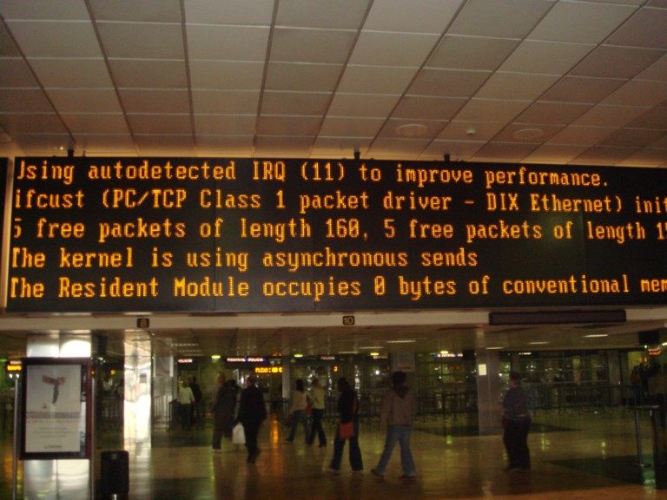
Consequences of Commoditization
Consequences of commoditization
More emphasis on integration rather than programming
Increased technology convergence & standardization
Mass market economies of scale for technology & personnel
More disruptive technologies & global competition
Lower priced—but often lower quality—hardware & software components

Slide 45

Consequences of Commoditization
Consequences of commoditization
More emphasis on integration rather than programming
Increased technology convergence & standardization
Mass market economies of scale for technology & personnel
More disruptive technologies & global competition
Lower priced—but often lower quality—hardware & software components
The decline of internally funded R&D
Notes:
http://www.flickr.com/photos/40143737@N02/3985074713/

Slide 46

Consequences of Commoditization
Consequences of commoditization
More emphasis on integration rather than programming
Increased technology convergence & standardization
Mass market economies of scale for technology & personnel
More disruptive technologies & global competition
Lower priced—but often lower quality—hardware & software components
The decline of internally funded R&D
Potential for complexity cap in next-generation software systems
See www.sei.cmu.edu/uls for more info on Ultra-Large-Scale (ULS) systems
Notes:
http://www.flickr.com/photos/73645804@N00/2473052504/

Slide 47

Consequences of Commoditization
Consequences of commoditization
en.wikipedia.org/wiki/Ozymandias
Not all trends bode well for long-term success of traditional technology leaders
Notes:
http://www.flickr.com/photos/savingfutures/3263126455/sizes/o/

Slide 48
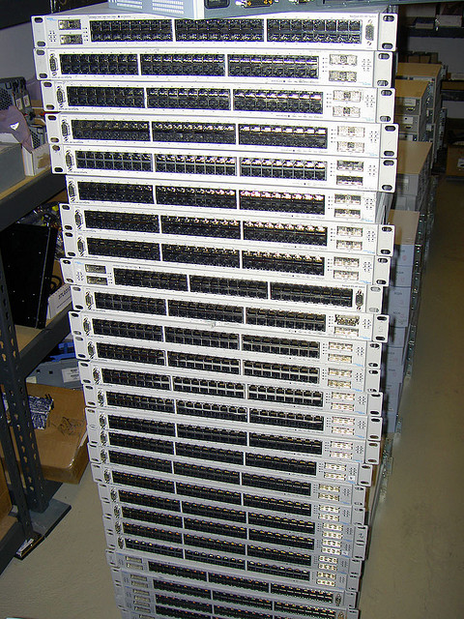
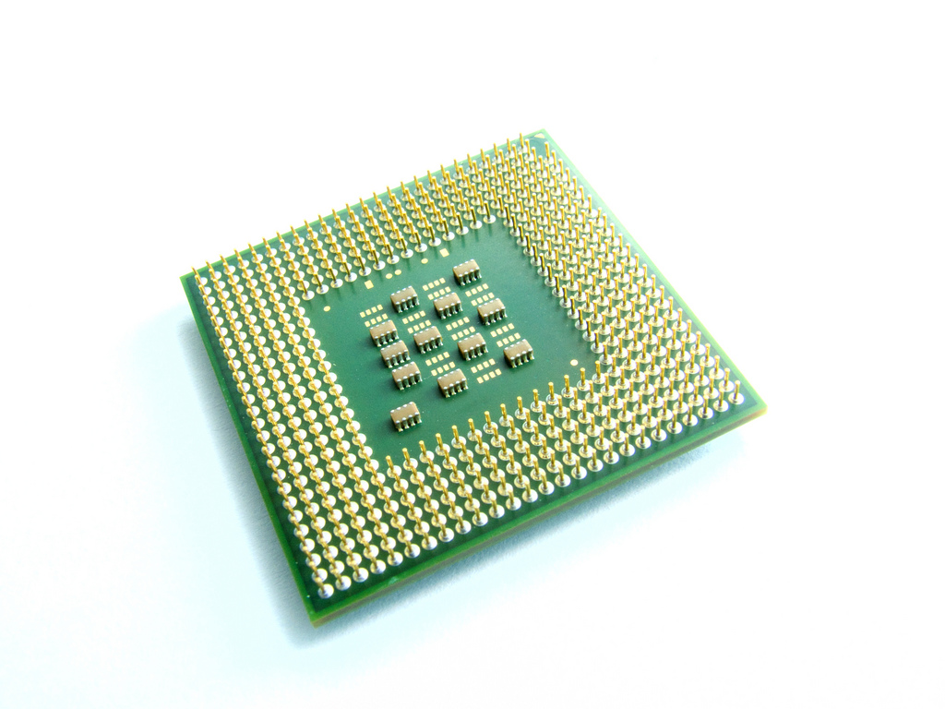
Summary
Over the past decades we've benefited from hardware commoditization

Slide 49
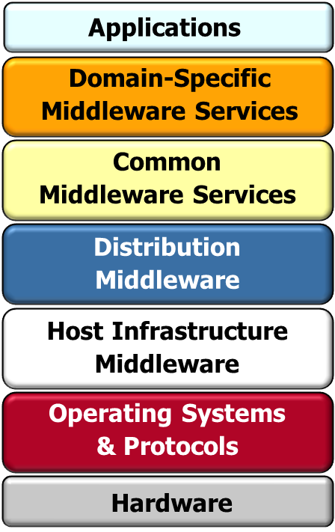
Summary
Over the past decades we've benefited from hardware commoditization
More recently, advances in programming languages, operating systems, & middleware are helping commoditize many software layers & components

Slide 50



Summary
Over the past decades we've benefited from hardware commoditization
More recently, advances in programming languages, operating systems, & middleware are helping commoditize many software layers & components
Although software quality generally lags hardware, improvements are enabling off-the-shelf software infrastructure use in mission-critical domains
Modalities
e.g., MRI, CT, CR, Ultrasound, etc.
Notes:
http://www.flickr.com/photos/35448539@N00/2378242121/, http://www.flickr.com/photos/50115004@N00/6941824942/, HotWheels - '09 Corvette Stingray Concept, http://www.flickr.com/photos/10581663@N08/4165107555/, http://www.flickr.com/photos/7617731@N02/3240810984/

Slide 51
Summary
Over the past decades we've benefited from hardware commoditization
More recently, advances in programming languages, operating systems, & middleware are helping commoditize many software layers & components
Although software quality generally lags hardware, improvements are enabling off-the-shelf software infrastructure use in mission-critical domains
In a commoditized environment, premium value & advantage accrues to individuals & organizations that master the patterns & frameworks needed to develop & integrate mission-critical concurrent & networked systems

